Slide 1
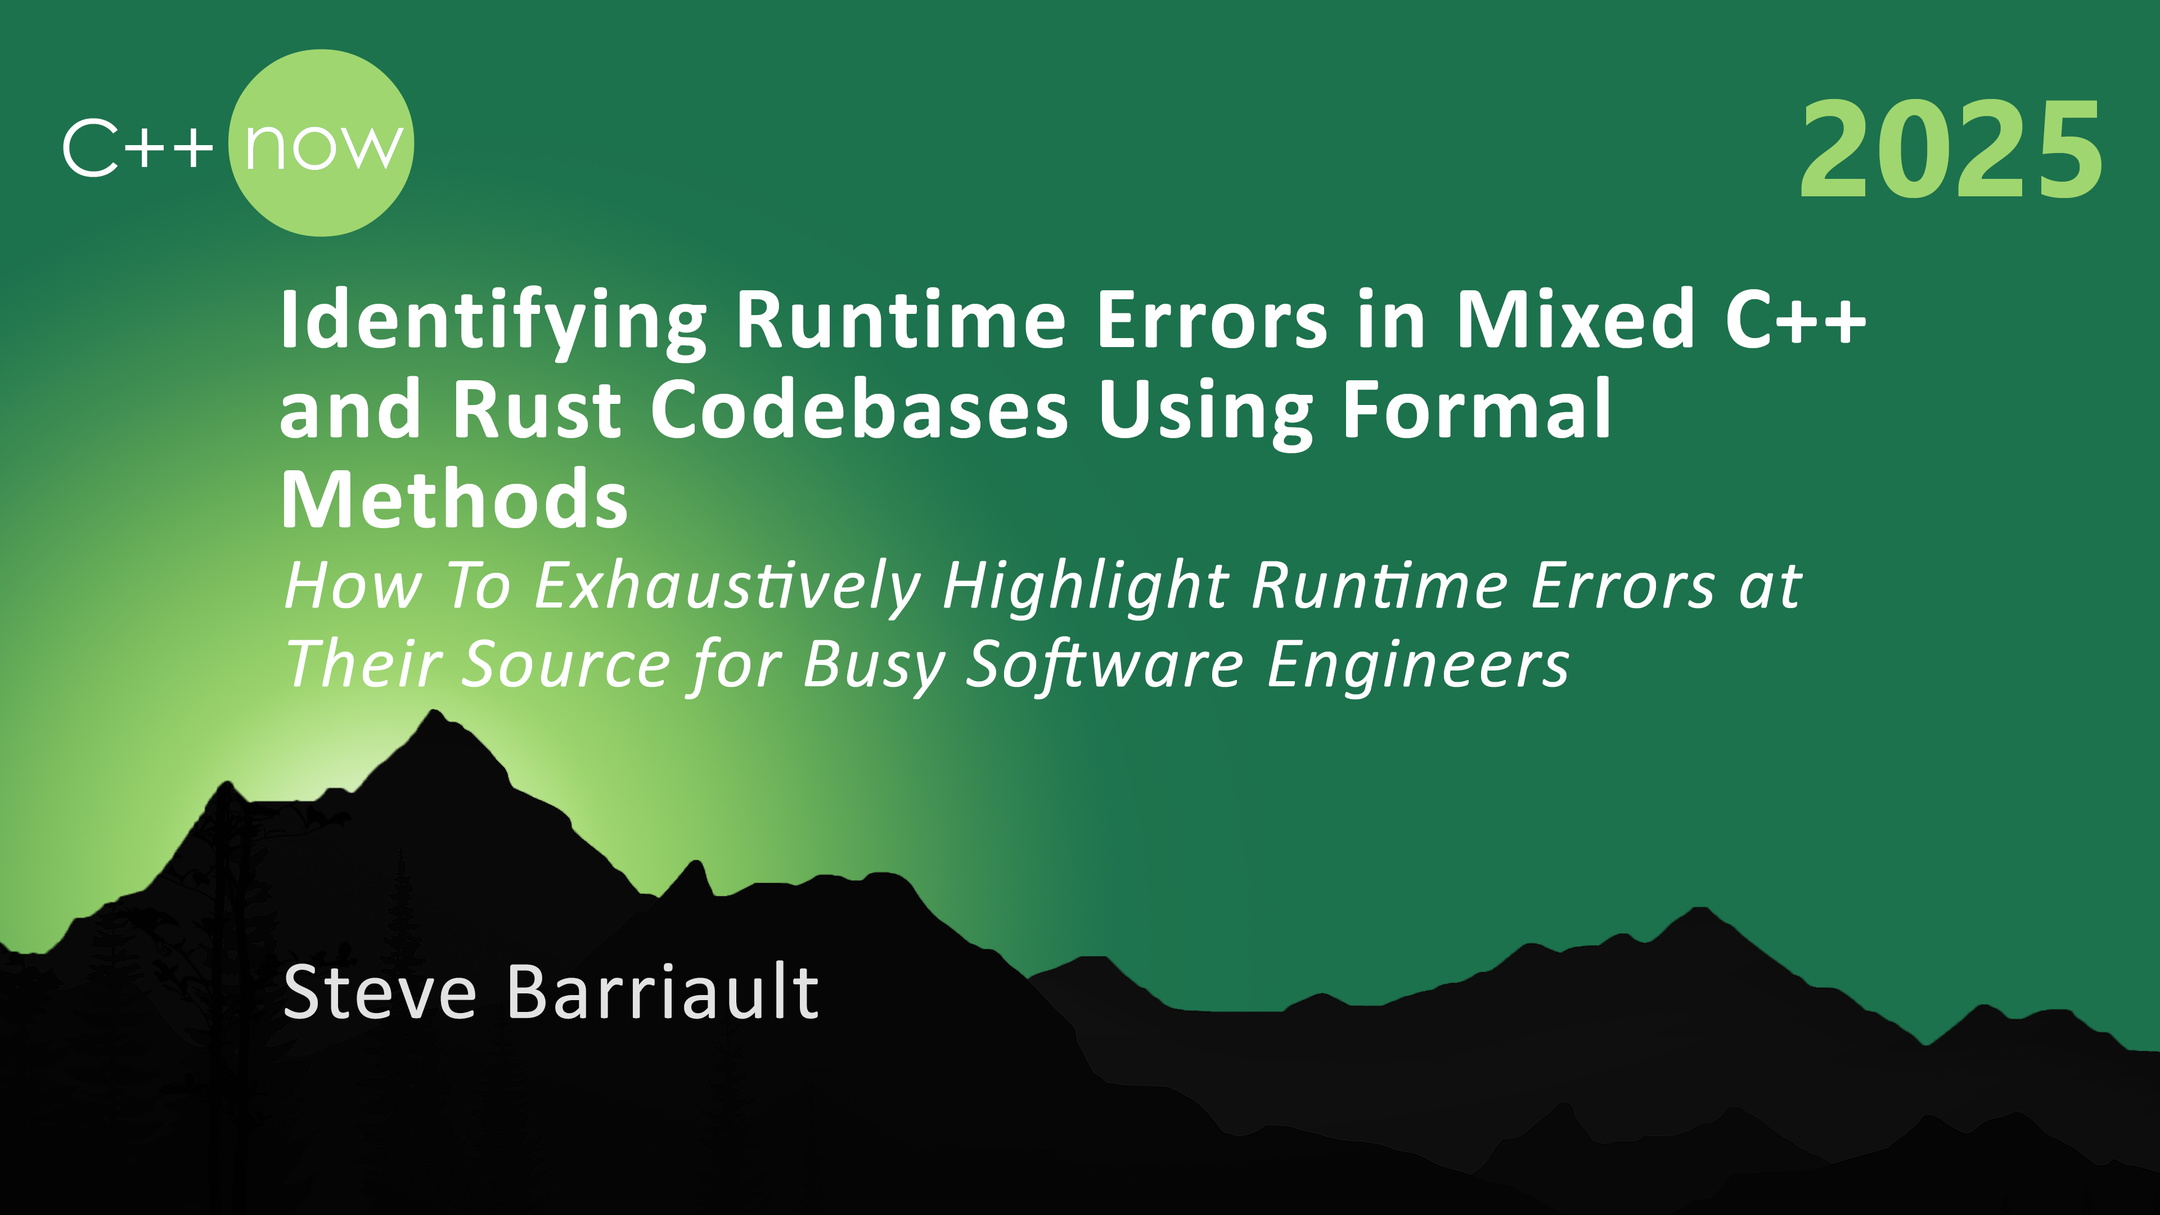
fewfwef

Slide 2
Formal Methods For Code Practitioners – An Overview
Runtime Errors In C++ And How Formal Methods Pinpoints Them
Are There Runtime Errors In Rust / Formal Methods Applicability
Formal Methods In Mixed C++ / Rust Codebases

Slide 3
Formal Methods For Practitioners

Slide 4
What are formal methods?
"Formal Methods" refers to mathematically rigorous techniques & tools for the specification, design & verification of software and hardware systems.
Mathematically rigorous: The analysis can be counted on to be sound and correct based on the inputs you give at the entry points
Rigorous logic: Can be checked by a “mechanical process” – i.e. “do the math”
They provide a means to symbolically examine the entire state space of a digital design (…) and establish a correctness or safety property that is true for all possible inputs.
It can be exhaustive – no false negatives
False positives may still exist
(https://shemesh.larc.nasa.gov/fm/fm-what.html)

Slide 5
Practically
Formal methods would be implemented in a tool
Albeit theorically possible, “doing it by hand” would be prohibitively expensive
You give the tool the information necessary to conduct the analysis
Requires some of the code
May require the specifications depending on the bugs you are hunting for
The tool uses that information to compute the different combination of values at specific points in the program
So the computations can be resolved in a reasonable time span, the tool will need to apply formal method techniques such as Abstract Interpretation
The tool will then use the results of the analysis to provide diagnostics
Such as if an error can occur, will occur, will never occur, or the code can’t be reached

Slide 6
Input that is needed
Functional Analysis
Goal is to prove that the code attains its specifications
So it requires:
The code itself
Info about values at entry points
The specifications in a notation format that is rigorous
The specifications need to be entered in a rigorous notation such as ACSL
Possible – but time-consuming and can be difficult
Runtime Error Detection
Goal is to demonstrate that the code is reliable & robust
So it requires:
The code itself
Info about values at entry points (by default, type range)
Tool must understand which operations may lead to hazardous computations
No need for specs: errors are « baked in » the code
Much easier and faster / cost-efficient

Slide 7
Runtime errors
Operations in the code that can lead to undefined behaviors or other behaviors that may lead to undesirable outcomes
We are assuming here that these are NOT intentional – they are accidentally ignored
In C++, examples include:
Division by zero
Out-of-bound array accesses (read or write)
Overflows / underflows
Memory leaks
The code may be achieving its goals – just not reliably
These are typically triggered by specific combination of values
Small subset of the overall possible values of the program
Consequences may include:
Crashes
Faulty behaviors
Security flaws
MITRE 2023
50% of all software flaws reported in embedded applications are overflows
Over 70% of all software flaws reported in embedded applications are runtime errors
Notes:
Rajouter des données du MITRE

Slide 8
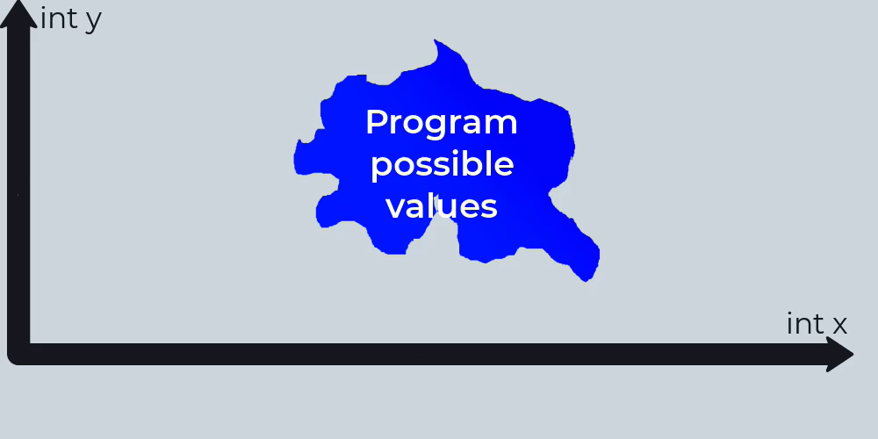
An image is worth a thousand words
The blue zone is an abstract representation of all the possible values in a given program
The problem is that in reality we do not know the boundaries of that shape
And in reality, that shape is probably mind-boggingly complex!
If the combination of values intersect with the zones where runtime errors can occur (in red), an error may be experienced during execution

Slide 9
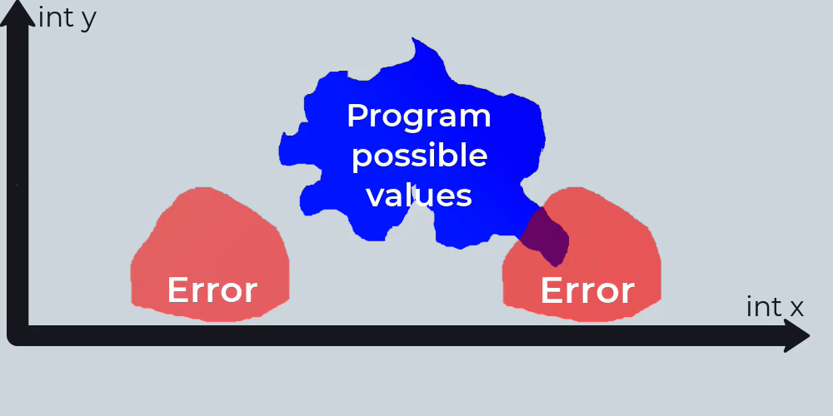

One option: Testing
The goal of testing here is to try to check if a test case can really “hit” one of these “error zones”
But we still do not know where these are, or how many are there
Even if it hits the right value, the consequences may not be immediately apparent
Ex: memory corruption without a read may remain symptom-less
This is why sanitizers are used with fuzzers
When are you done testing?
Boeing
Integer Overflow
On the Boeing 787, the software counter internal to the generator control units will overflow after 248 days of continuous power, causing that GCU to go into failsafe mode.
→ Boeing 787 Dreamliners have to be switched off every 248 days to avoid the plane losing electrical power.

Slide 10
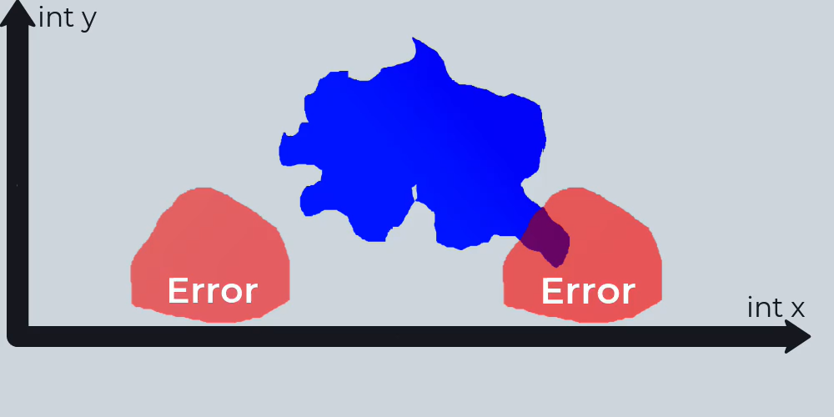
Formal Methods – Abstract Interpretation
You gather the code and information about its entry points (main, stubs, etc)
By default, assume everything is full range based on type
Assume the worst (so new could return null)
Modelize the code and cascade these ranges of values through the model
Since you need something that computes in finite time, simplify the figure

Slide 11
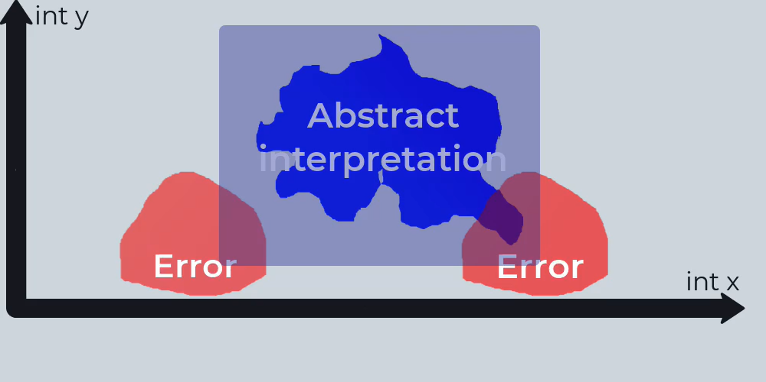
Formal Methods – Abstract Interpretation
You gather the code and information about its entry points (main, stubs, etc)
By default, assume everything is full range based on type
Assume the worst (so new could return null)
Modelize the code and cascade these ranges of values through the model
Since you need something that computes in finite time, simplify the figure
Refine the analysis so the figure espouses the reality as much as possible while always being an over-approximation

Slide 12
False negatives vs false positives
False negatives (i.e. indicate the absence of an error that actually is present) is mathematically not possible as long as the entry values that are considered are the full range of the type
Some false positives (i.e. indicate the presence of an error where there is none) can occur
Some can be eliminated through spending more time in the analysis, and/or better algorithms to implement formal methods
For libraries, critical code and/or highly reusable code, full-range approach is generally suitable
In other circumstances, engineers may consider that using functional (restrictive) ranges in entry (as opposed to full type ranges) may be good enough
The same methods would apply, but the absence of false negatives would only hold if the hypotheses on the entry values hold as well
Notes:
For functional range, use char values – it will be more impactful than int or larger values (and more realistic too)

Slide 13
Pinpointing Runtime Errors in C++ With Formal Methods

Slide 14
Runtime errors
Operations in the code that can lead to undefined or undesirable behaviors
In C++, examples include:
Division by zero
Out-of-bound array accesses (read or write)
Overflows / underflows
Memory leaks
The code may be achieving its goals – just not reliably
These are typically triggered by specific combination of values
Small subset of the overall possible values of the program

Slide 15

Do they really matter?
In a word: yes
MITRE: 50% of all software flaws reported in embedded applications are overflows
MITRE: Over 70% of all software flaws reported in embedded applications are runtime errors
Security-wise, buffer overflows are a “must-go” for hackers
WhatsApp
CVE-2022-36934 CVSS 9.8 - Critical
Integer Overflow
An integer overflow in Video Call Handler could be manipulated to propagate to heap buffer overflow and achieve arbitrary RCE.
→ Attackers could perform arbitrary code execution on device

Slide 16
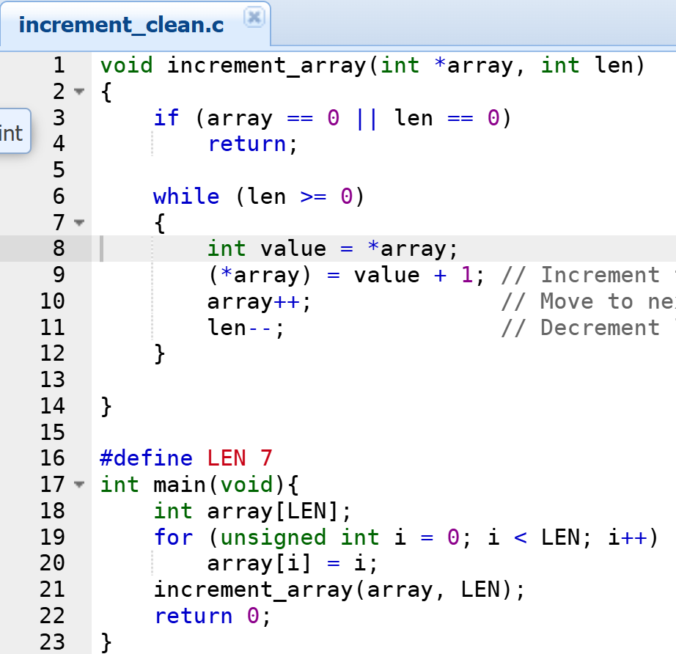
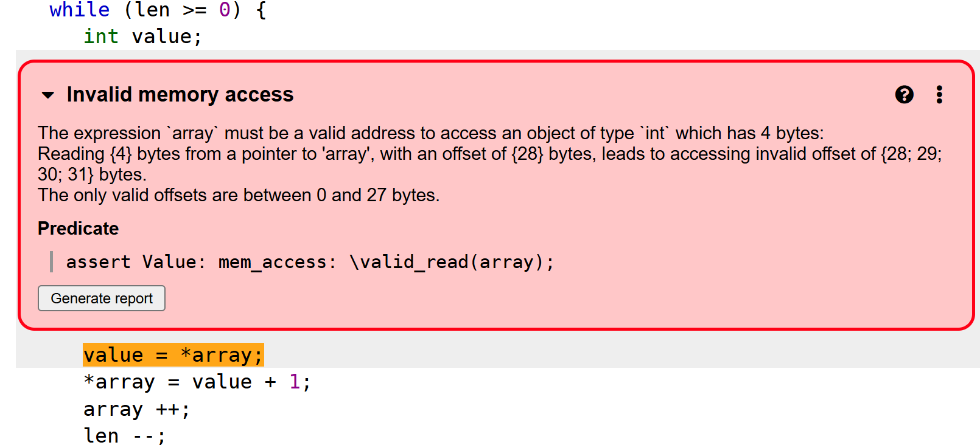
From C: Out-of-bounds array access
0
4
8
12
16
20
24
28
32
Memory representation
7
0 | 1 | 2 | 3 | 4 | 5 | 6
{
Another entity
Consequence: Depends on what happens when if/when we read that memory allocation (We changed the value that was stored there, and it may be « owned » by another entity)

Slide 17
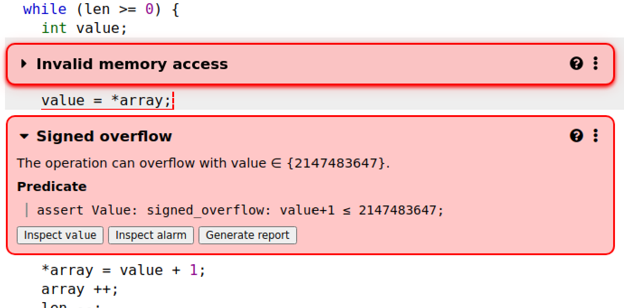
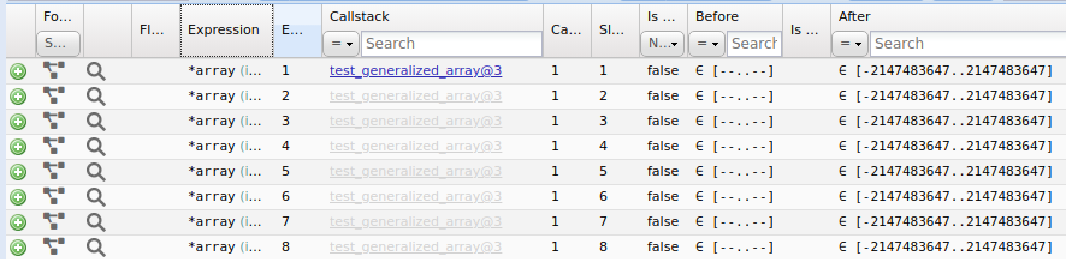
From C: Overflow
Here, if we stipulate that all entries to our function can be full range (INT_MIN .. INT_MAX)
Formal method can consider single values – or continuous ranges, or disjoint ranges
Can’t go to 2,147,483,648!
Consequence: Undefined behavior (Anything can happen, compiler does what it feels is best)

Slide 18
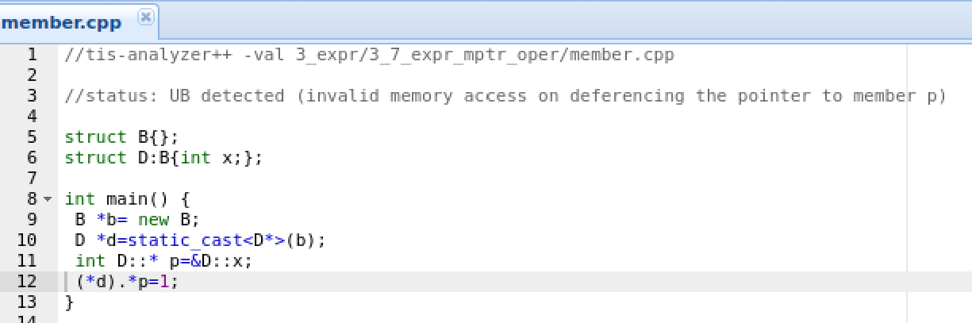
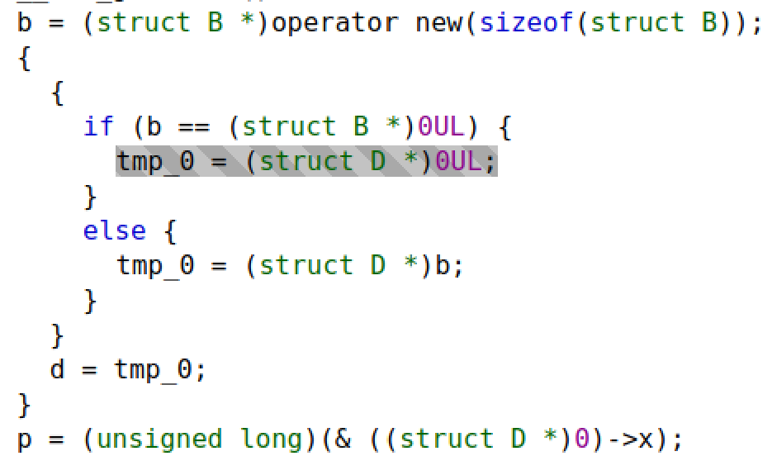
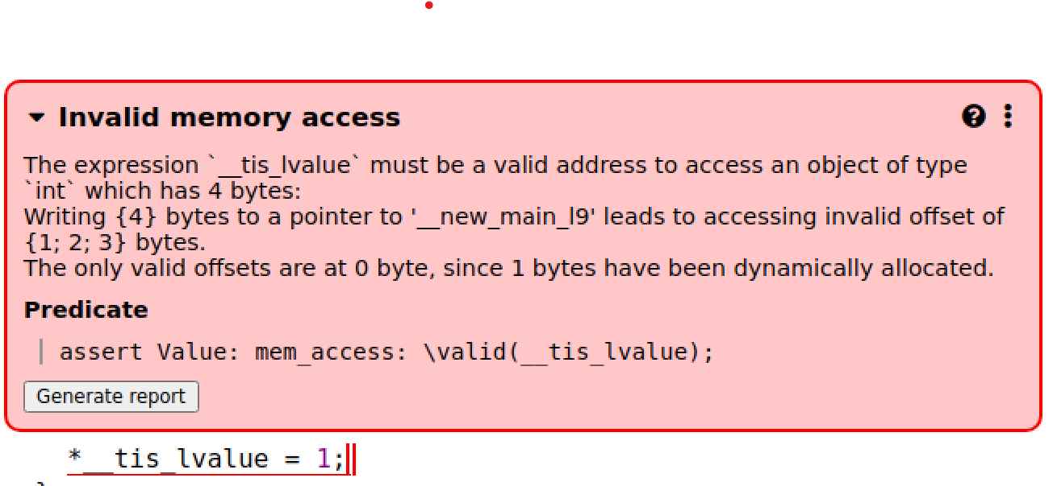
From C++: Cast that went wrong
Allocate B (no member x)
“Disambiguated steps”
Cast to D (which has x)
That cast leads to an undefined behavior, but the consequence occurs when trying to write to x
In order to do this, formal method must keep a representation of how the struct (or class) would be represented on the heap
Trying to assign to x (not allocated)
Consequence (here):
Memory corruption
Notes:
The invalid cast is an undefined behavior, but we detect the consequence If you do not do anything with this cast it will never be detected.

Slide 19
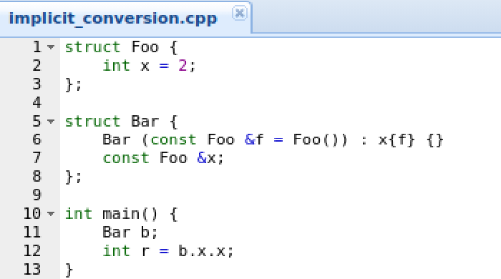
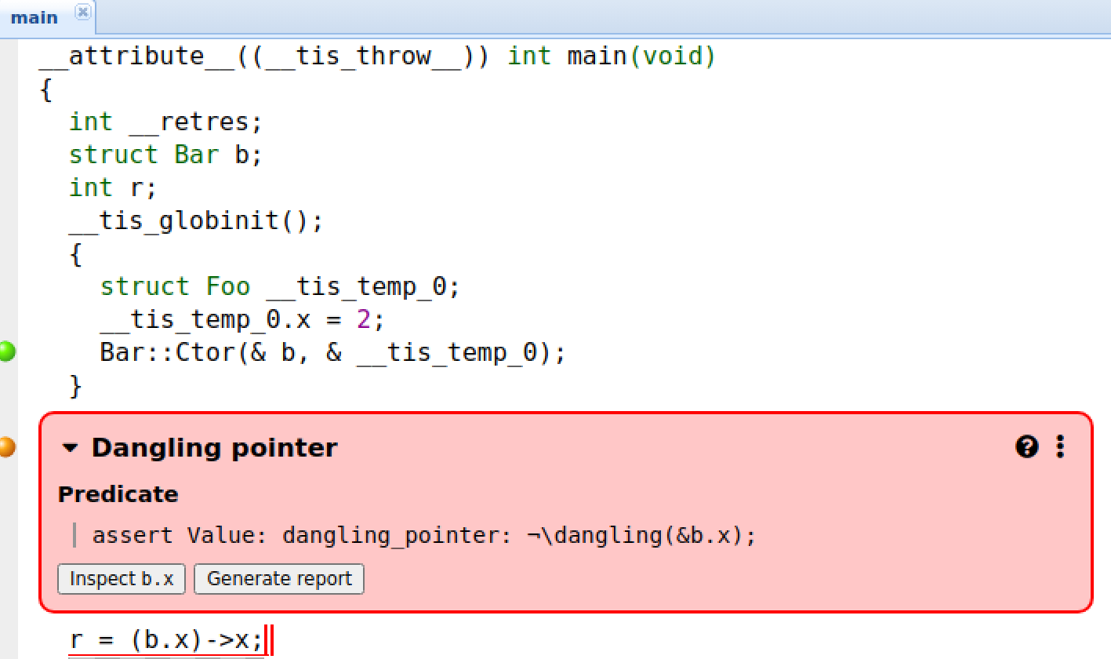
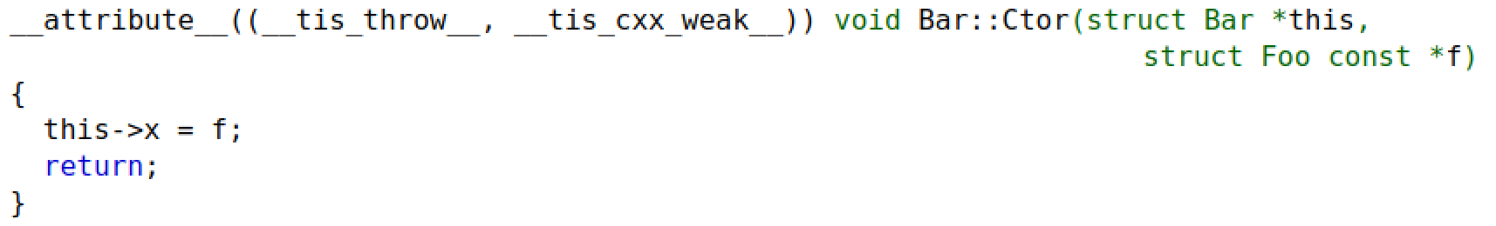
From C++: Dangling reference
“Disambiguated steps”
Foo correctly constructed (x)...
… But Foo goes out of scope
In order to do this, formal method must keep a representation of how the struct (or class) would be represented on the stack/heap
Accessing Bar.Foo->x points to something that no longer exist
Consequence:
Pointers that point in places with random data

Slide 20
Does Rust have runtime errors? If so, can Formal Methods detect them?

Slide 21

Rust as a “memory-safe” language
The premise of Rust is to prevent users from building code that is “risky” by policing what developers can (and cannot) do
The Rust compiler will zealously enforce many rules, which includes
All variables are constants, until you prefix them with mut
Allocations to the heap are made by smart pointers, which “own” the object
Pointer goes out of scope ➔ the heap object is dropped (deallocated)
You can have many “borrows” on a heap object in read mode, but only one in write mode.
If writing, only one “borrow” can exist
Good presentation by Lisa this AM!
Etc
The Rust compiler as seen by some as…
So, problem solved? No more runtime errors?
…Not quite…

Slide 22
Runtime errors in Rust
Two categories of runtime errors exist in Rust:
Those that happen in code declared unsafe
Those that happen in code that is NOT declared unsafe

Slide 23
Code declared as unsafe in Rust
From the Rust Book Unsafe Rust exists because, by nature, static analysis is conservative. When the compiler tries to determine whether or not code upholds the guarantees, it’s better for it to reject some valid programs than to accept some invalid programs. Although the code might be okay, if the Rust compiler doesn’t have enough information to be confident, it will reject the code.
Some application of unsafe code includes:
Low-level hardware accesses
by default, the compiler cannot infer if the value remains the same between write operations (in C++ parlance, it is volatile)
Effect on writing on specific addresses is unknown to the compiler -> crash? Block HW?
Performance enhancements not otherwise available
Calls to functions written in other languages, like C++
Convenience (“trust me, I know what I am doing”)

Slide 24
Unsafe “superpowers”
Dereference a raw pointer
Call an unsafe function or method
Access or modify a mutable static variable
Implement an unsafe trait (analogous to class methods)
Access fields in a union
Using unsafe to take one of the five actions (superpowers) just discussed isn’t wrong or even frowned upon. But it is trickier to get unsafe code correct because the compiler can’t help uphold memory safety. -- Rust Book

Slide 25
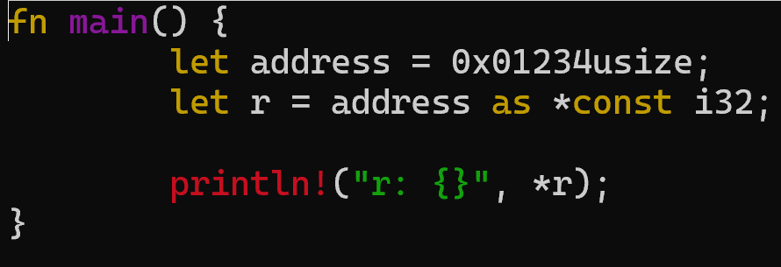
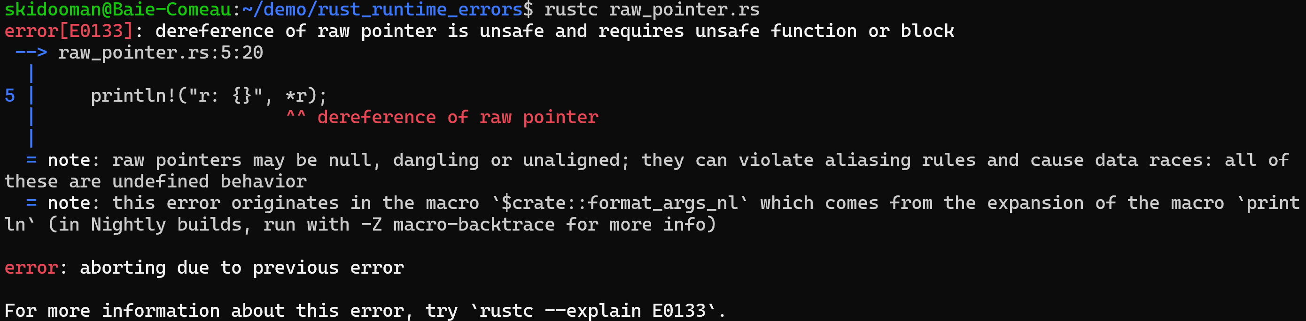
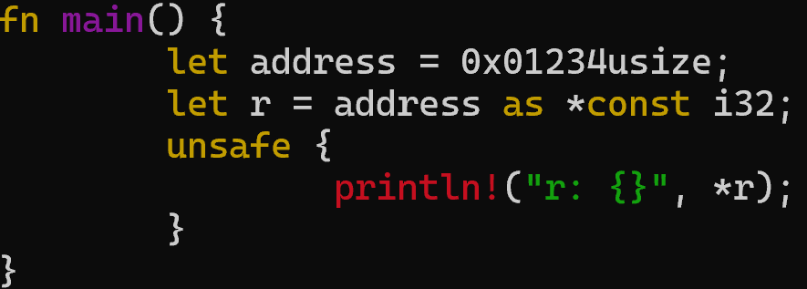
Example: Reading a raw pointer (HW)
Consequences
User space -> segmentation fault
Kernel space -> unstable OS
Formal methods would:
Modelize memory access, inclusive of absolute addresses like this
Assume that value can be anything (volatile)
Be able to detect problems during ptr arithmetic
https://doc.rust-lang.org/book/ch20-01-unsafe-rust.html

Slide 26
Runtime errors in “safe” code in Rust
If a dangerous operation:
Is not forbidden by the compiler
Is not a recoverable error; OR is recoverable but not handled (i.e. “unwrap”)
Is experienced at runtime
The thread will enter panic state
There is no way back to normal execution
Other threads (if present) can continue – but depending on your overall program, it may lead to undesirable behavior

Slide 27
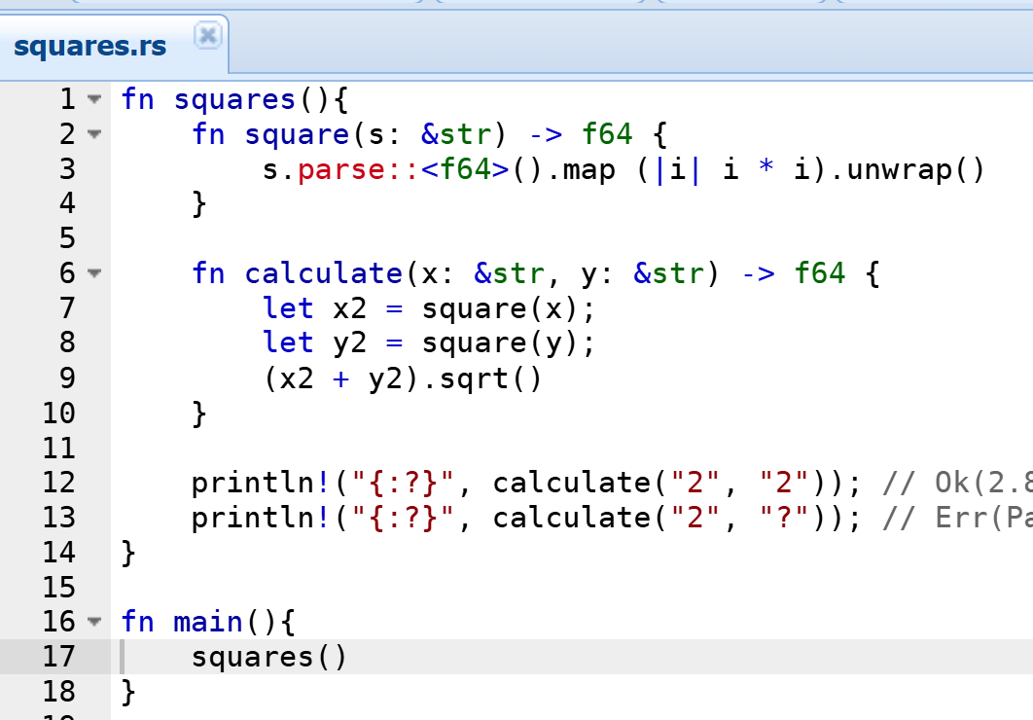
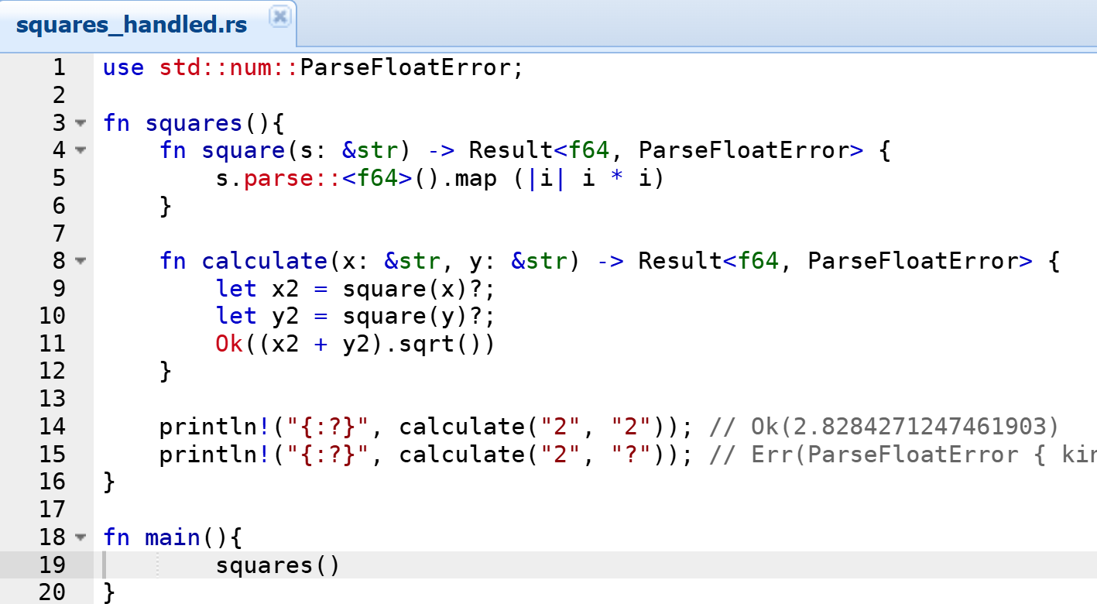
Runtime errors in “safe” code in Rust
Result of that conversion comes with error return
Result <actual_result, error>
Conversion would return Result<rslt, error>, forcing developers to explicitly access the desired values
https://medium.com/better-programming/error-handling-in-rust-that-every-beginner-should-know-9efa59deb934

Slide 28
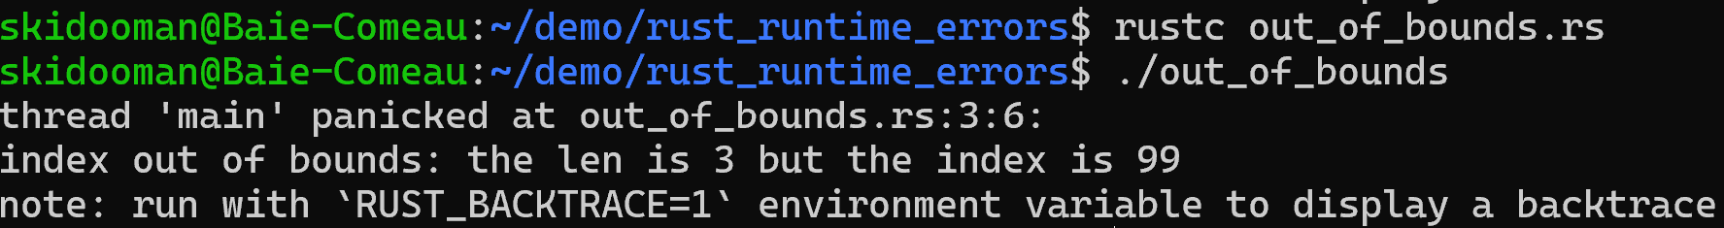
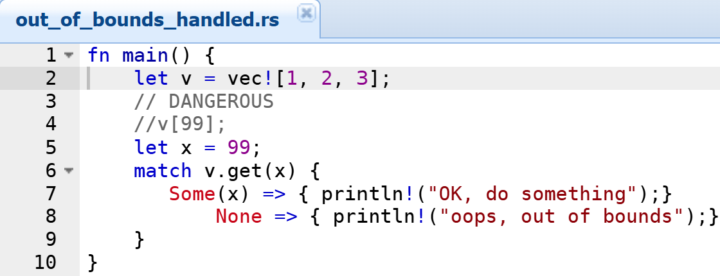
Runtime errors in “safe” code in Rust
Take this code:
fn main() { let v = vec![1, 2, 3]; v[99]; }
It will compile, even if the code is not marked “unsafe”
It will call for the panic! macro during execution
Formal method would be able to find the error here – even if the out-of-bounds index is the result of a complex calculation
Out-of-bounds array access is NOT a recoverable error
You could “handle” it through defensive code, just like in C++
Need to know it can happen
Still need to handle it somehow
https://doc.rust-lang.org/book/ch09-01-unrecoverable-errors-with-panic.html

Slide 29
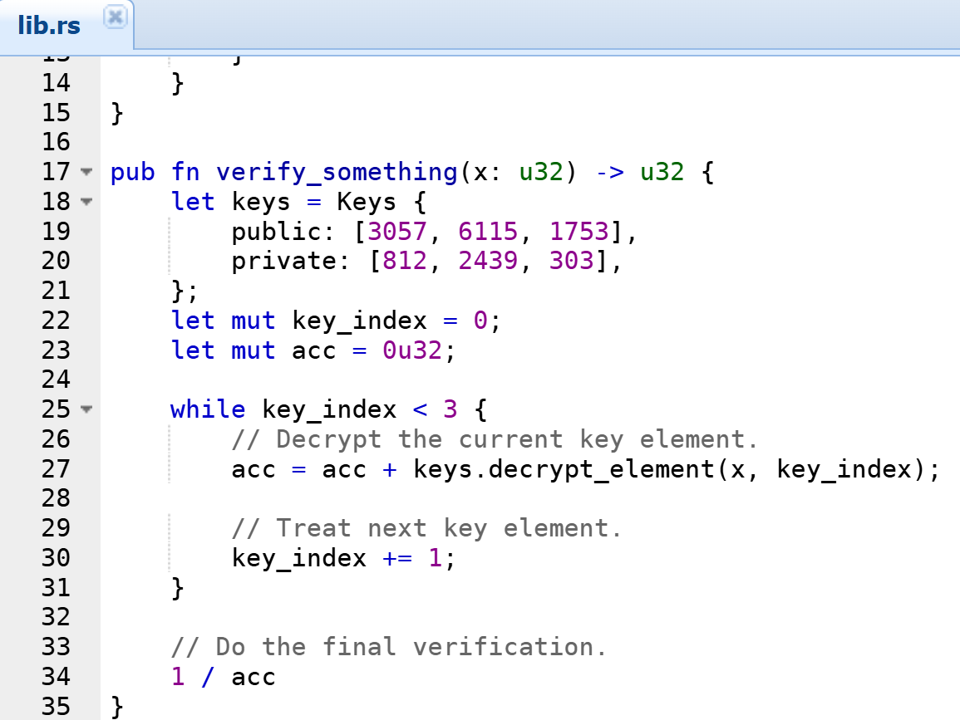
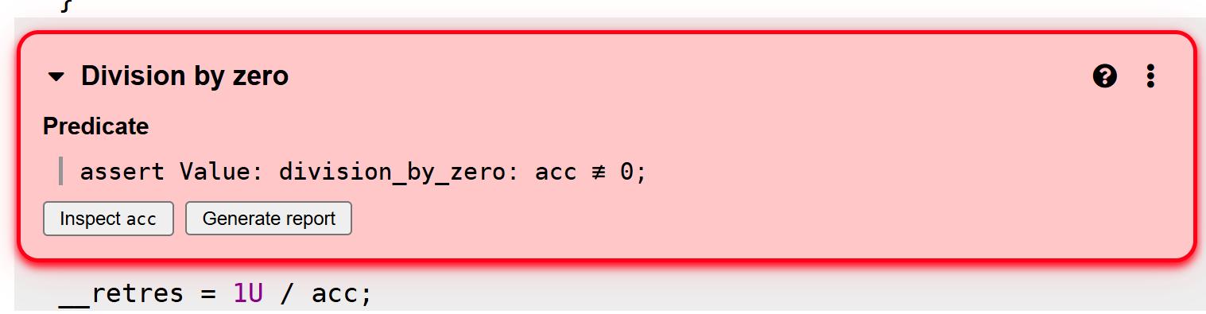
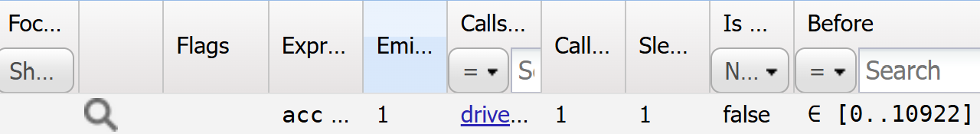
Divisions by zero – still “safe” code
Passing full uint range (includes 0)
From Benjamin Monate, CTO:
In Rust, it will stop violently but cleanly
In C++, it will probably stop violently, but perhaps not as cleanly (ex: effects are felt later on)

Slide 30
So, is Rust safe?
By limiting developers’ options and trying to detect as many errors as possible at compile time, Rust can be considered safer than C/C++.
At the cost of additional restrictions on developers
But runtime errors and unwanted behaviors can still exist
In unsafe code
And in “safe” code
Some constructions of C++ can also be used to mitigate some risks, such as smart pointers for heap objects
Formal Methods can be used to find these runtime errors in Rust, just as in C and C++

Slide 31
Formal Methods In Mixed C++ / Rust Codebases

Slide 32
Mixed code bases
Many actors in the industry are betting on Rust as a viable pathway for a number of projects, including critical / low-level / embedded
But C++ has a strong legacy that will enable it to prosper
Lots of legacy, “tried-and-true” C++ code bases that will be interfaced with Rust
C++ is a known and reliable way that will also see its share of new development
Under these conditions, how should one verify mixed code bases?
As two separate projects, one per language?
As a unified project?

Slide 33
Mixed codebase strategy
Individual analyses
Run formal methods on C++ and Rust code separately
Use full « generalization » - that is, by default, full range of the types
Do this for all entrypoint values
Because Formal Methods won’t yield false negatives, you can ensure unparalleled robustness
But you may have a number of false positives that in fact won’t happen in the mixed code
Unified analysis
Run formal methods by treating the code in C++ and Rust as if they were one
Thus, if the C++ code calls Rust (or Rust calls C++), the range resulting of that call will be considered for the analysis
Instead of full range
Result: you still get no false négatives, but you may also reduce the number of false positives in that specific context

Slide 34
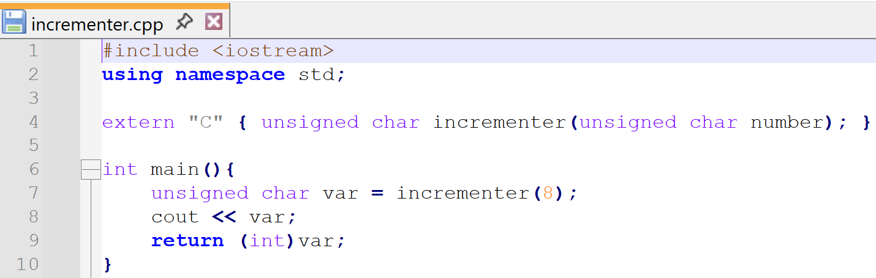
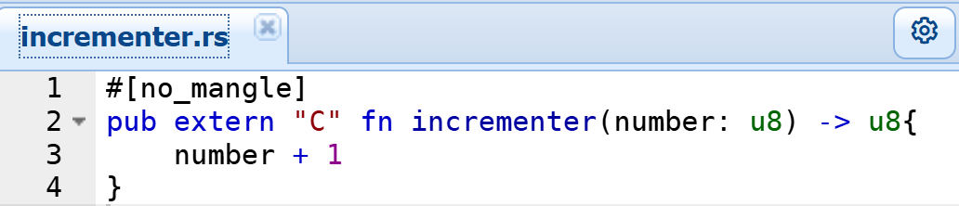
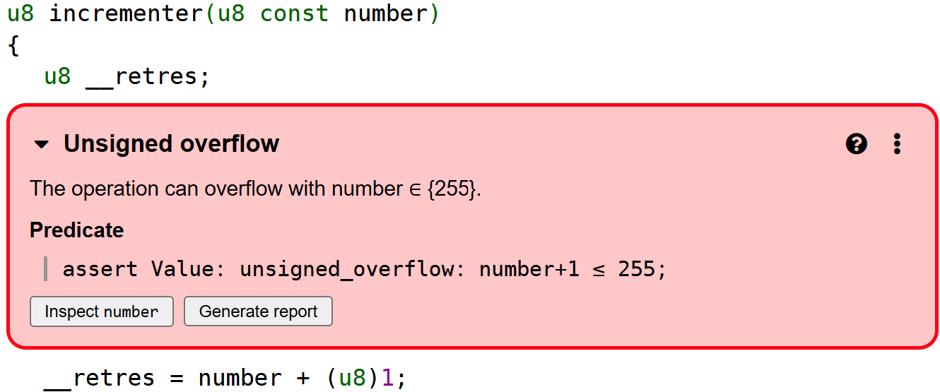
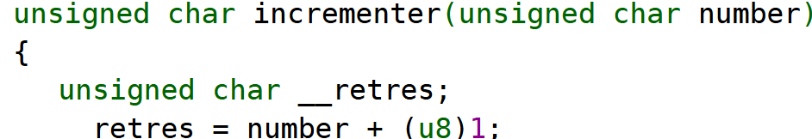
Simple overflow example
If we are analyzing that Rust library in isolation, formal methods will conclude there can be an overflow
Because by default inputs are full-range, so UCHAR_MAX
Correct strategy for reusability
If we analyze it with the C++ code calling that Rust function, then the error goes away
Because in this context, the Rust code will never overflow
No bug (passing single value 8)

Slide 35
Conclusions
Rust, just like any (low-level) language, still can have runtime errors
Formal methods (including abstract interpretation) can be used to find runtime errors exhaustively
No false negative proven by advanced math operations
There are strategies to reduce “perceived” false positives, such as restricting input values to predefined functional ranges
Analyzing code bases written in C++ and in Rust in one analysis can also lower the number of alarms that may not be bugs in the context of a cross-language execution
And finally, my warmest thanks to my colleagues that helped put this presentation together
Benjamin Monate, CTO
Stéphane Zimmermann
And to the organizers for inviting me, and all of you for attending

Slide 36
steve.barriault@trust-in-soft.com https://www.linkedin.com/in/steve-barriault/
mike.shearman@trust-in-soft.com

